Slide 1
Simultaneous Linear Equations
Topic: Jacobi Method
Numerical Computing

Slide 2
Introduction
If systems of linear equations are very large, the computational effort of direct methods is prohibitively expensive
Three common classical iterative techniques for linear systems
  The Jacobi method
  Gauss-Seidel method
  Successive Over Relaxation (SOR) method
Matlab’s built-in functions

Slide 3
Iterative solution procedure
Write the system Ax=b in an equivalent form
x=Ex+f (like x=g(x) for fixed-point iteration)
Starting with x⁰, generate a sequence of approximations {x^{k}} iteratively by
x^{k+1}=Ex^{k}+f
Representation of E and f depends on the type of the method used
But for every method E and f are obtained from A and b, but in a different way

Slide 4
Convergence
As k→∞, the sequence {x^{k}} converges to the solution vector under some conditions on E matrix
This imposes different conditions on A matrix for different methods
For the same A matrix, one method may converge while the other may diverge
Therefore for each method the relation between A and E should be found to decide on the convergence

Slide 5


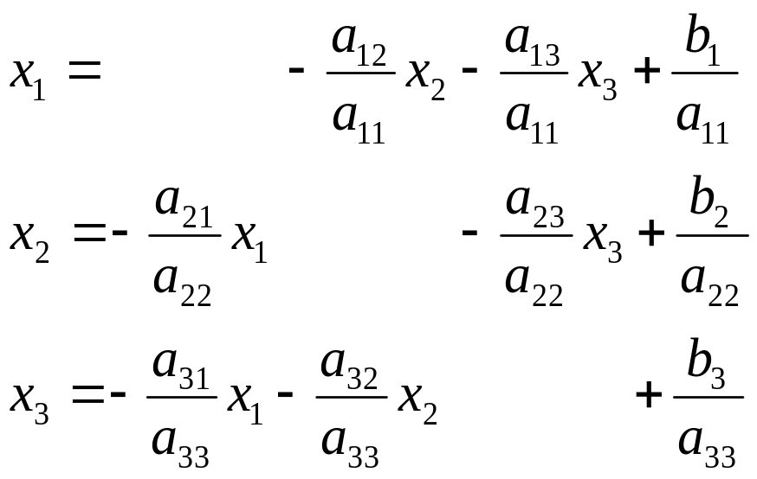
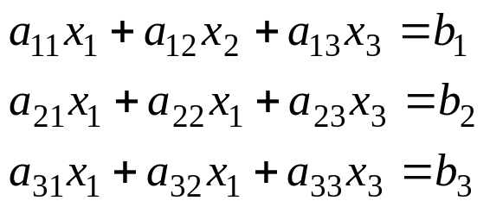


Basic Idea on Jacobi method
Convert the system:
into the equivalent system:
Generate a sequence of approximation

Slide 6
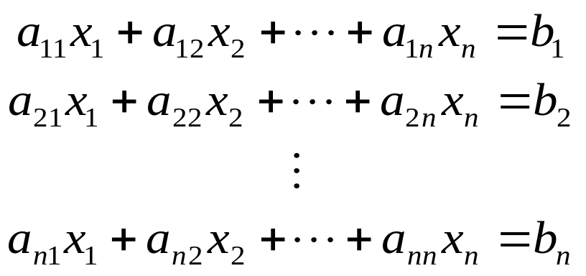
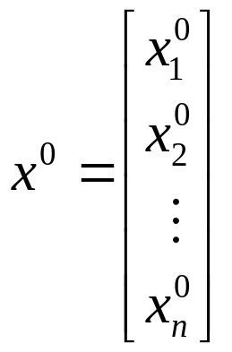
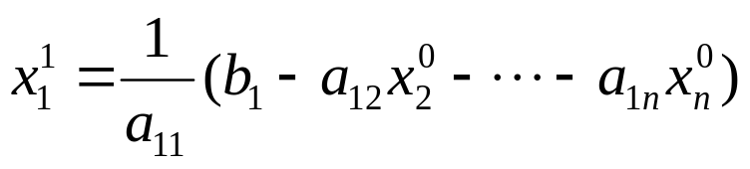
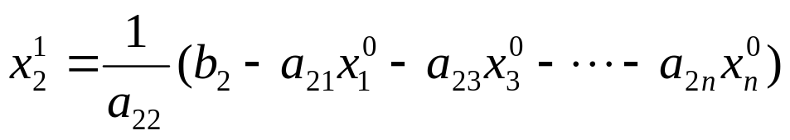
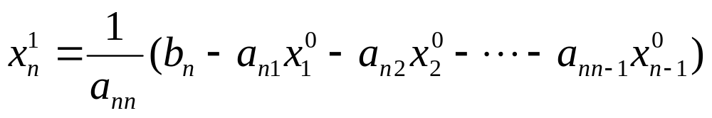
Jacobi iteration method

Slide 7
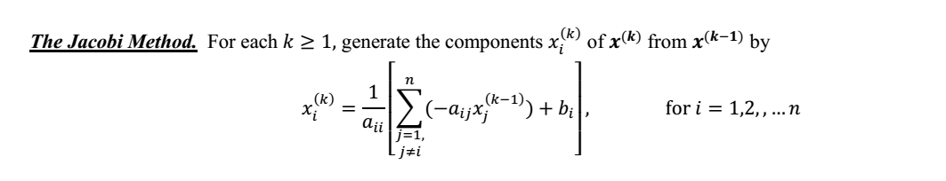
Algorithm

Slide 8
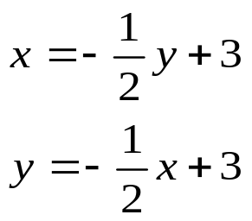
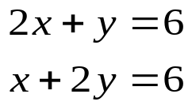

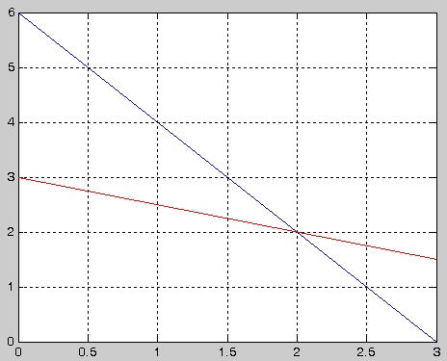

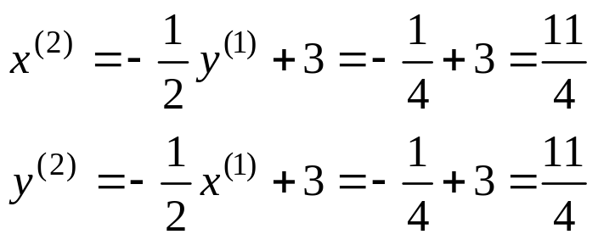



Jacobi Method with examples
Consider the two-by-two system
Start with
Simultaneous updating
  New values of the variables are not used until a new iteration step is begun

Slide 9
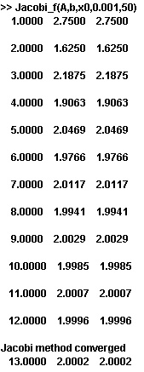
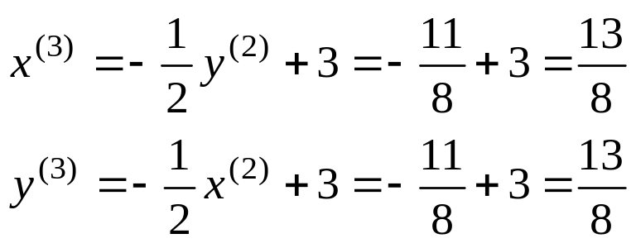
Jacobi Method
Con’t

Slide 10
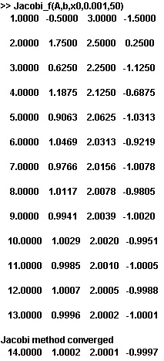
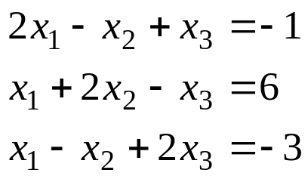
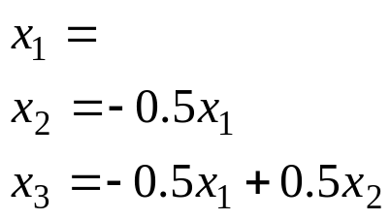
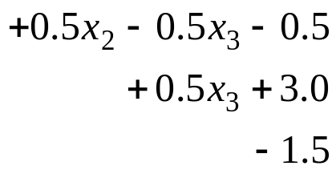
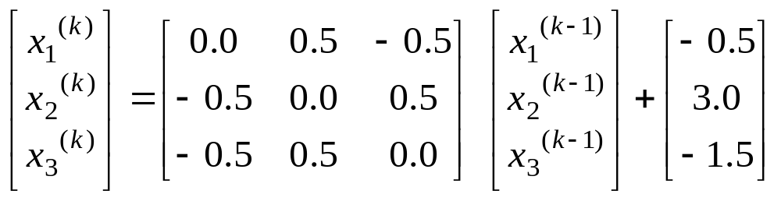

Jacobi Method
Consider the three-by-three system
Start with

Slide 11
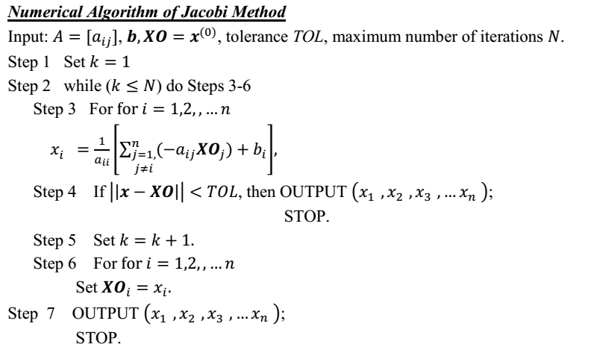

Slide 12
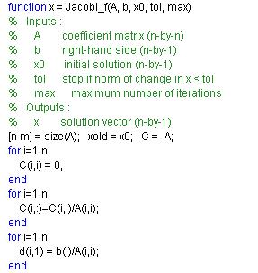
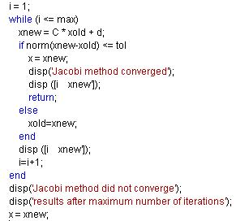
Jacobi Method
Matlab function for jacobi method

Slide 13
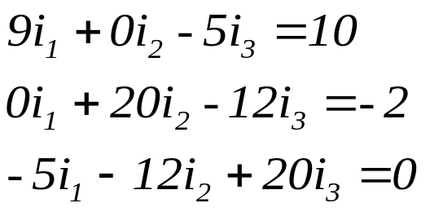
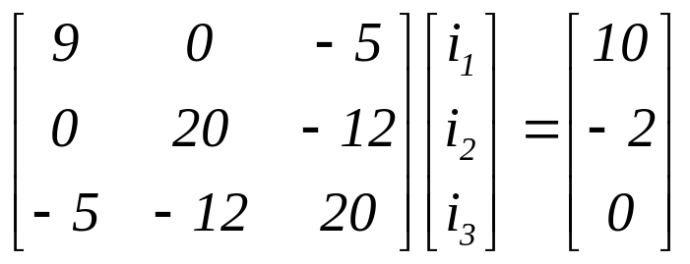
Jacobi method : Example 1
Consider a circuit shown in figure here; currents i₁, i₂, and i₃ are given by
4Ω
8Ω
i₂
2 V
i₁
10 V
12Ω
The matrix form is:
5Ω
i₃
3Ω
Notice that magnitude of any diagonal element is greater than the sum of the magnitudes of other elements in that row
A matrix with this property is said to be Diagonally dominant.

Slide 14
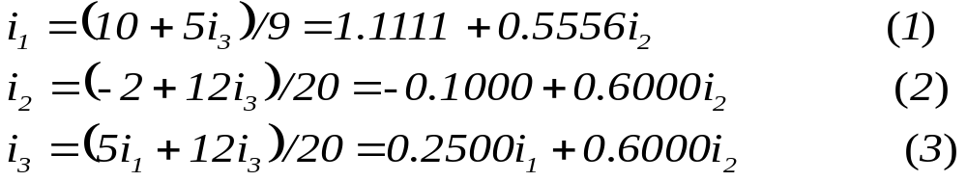
Jacobi method : Example 1
The set of equations:
Let us write for i₁, i₂ and i₃ as
Let us make an initial guess as
i₁ = 0.0; i₂ =0.0 and i₃ = 0.0
First iteration results:
i₁ = 1.1111; i₂ =-0.1000 and i₃ = 0.0

Slide 15
Jacobi method : Example 1
First iteration results:
i₁ = 1.1111; i₂ =-0.1000 and i₃ = 0.0
2nd iteration results:
i₁ = 1.1111; i₂ =-0.1000 and i₃ = 0.22
3rd iteration results:
i₁ = 1.23; i₂ = 0.03 and i₃ = 0.22
4th iteration results:
i₁ = 1.23 ; i₂ = 0.03 and i₃ = 0.33
5th iteration results:
i₁ = 1.29; i₂ = 0.1 and i₃ = 0.33
6th iteration results:
i₁ = 1.29; i₂ = 0.1 and i₃ = 0.38

Slide 16
Jacobi method : Example 2
4X₁ + 2X₂ = 2
2X₁ + 10X₂ + 4X₃ = 6
4X₂ + 5X₃ = 5
Solution: (X₁ , X₂ , X₃ ) = (0.41379, 0.17241, 0.86206)

Slide 17
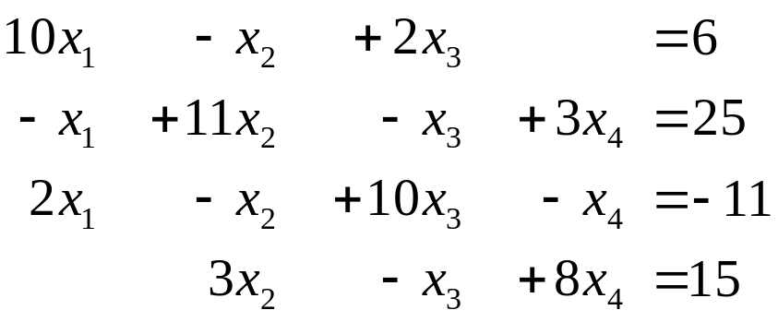
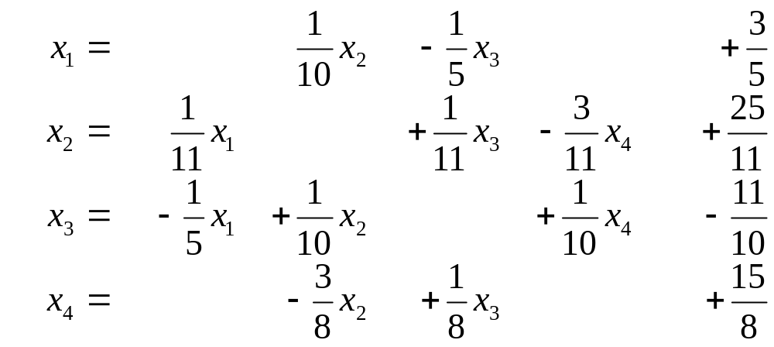
Jacobi method : Example 3
Consider the following set of equations.
Convert the set Ax = b in the form of x = Tx + c.

Slide 18
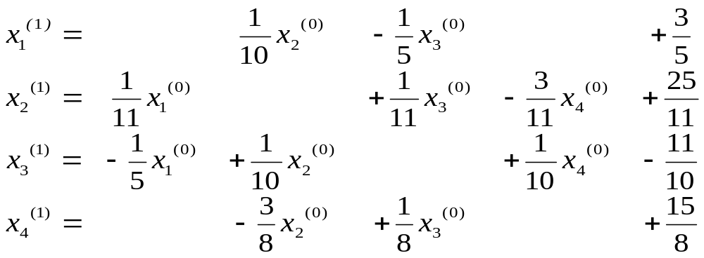

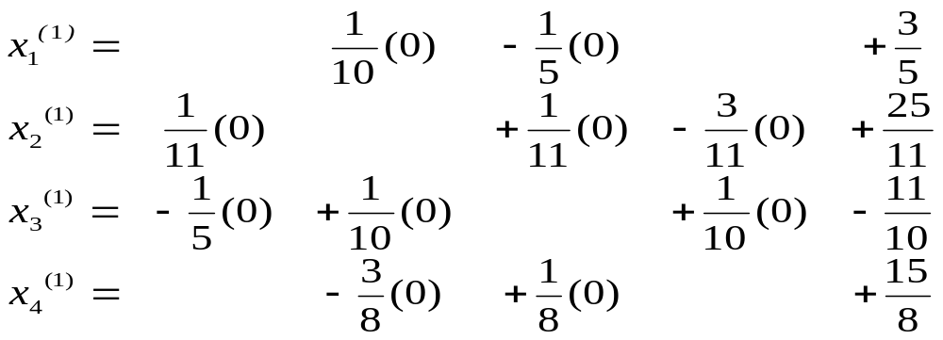
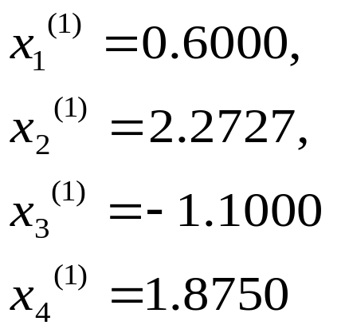
Jacobi method : Example 3

Slide 19

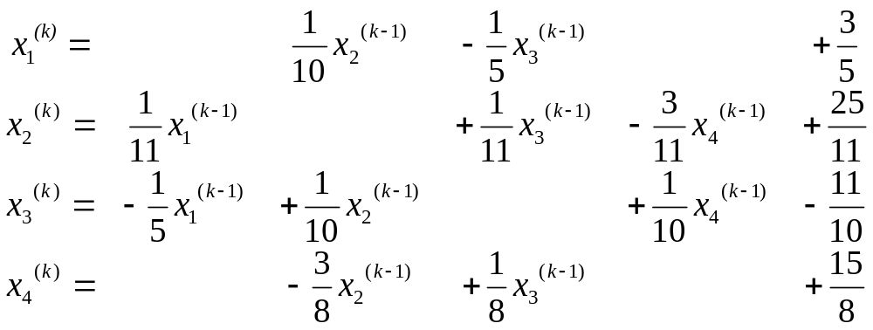
Jacobi method : Example 3

Slide 20
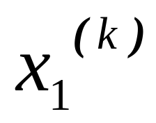
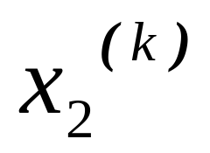
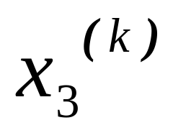
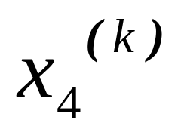
Jacobi method : Example 3
Results:
iteration | 0 | 1 | 2 | 3
 | 0.0000 | 0.6000 | 1.0473 | 0.9326
 | 0.0000 | 2.2727 | 1.7159 | 2.0530
 | 0.0000 | -1.1000 | -0.8052 | -1.0493
 | 0.0000 | 1.8750 | 0.8852 | 1.1309

Slide 21
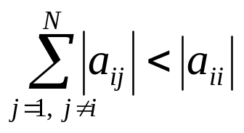
The rules
We set up the Jacobi iteration but did not ask the question “when will the Jacobi iteration converge and how fast?”
Definition:
A matrix A is diagonally dominant if
Theorem:
If the matrix A is diagonally dominant then Ax=b has a unique solution x and the Jacobi iteration produces a sequence which converges to x for any initial guess
Informally:
The “more diagonally dominant ” a matrix is the faster it will converge… this holds some of the time.

